Slide 1
Getting out of the Maze
Victoria’s Youth Justice System

Slide 2


We all remember making irrational decisions when we were teenagers – it was almost like we were a different creature!

Slide 3


But for the most part, we grew out of bad decisions into responsible adults

Slide 4

So when young people get theirs really wrong

Slide 5

Our systems needs to try and help them turn things around – for their sake….
The Australian Medical Association has found that detention increases children’s risk of:
Depression
Suicide and self harm
Poor emotional development
Poor education outcomes, and
Further fractures family relationships

Slide 6
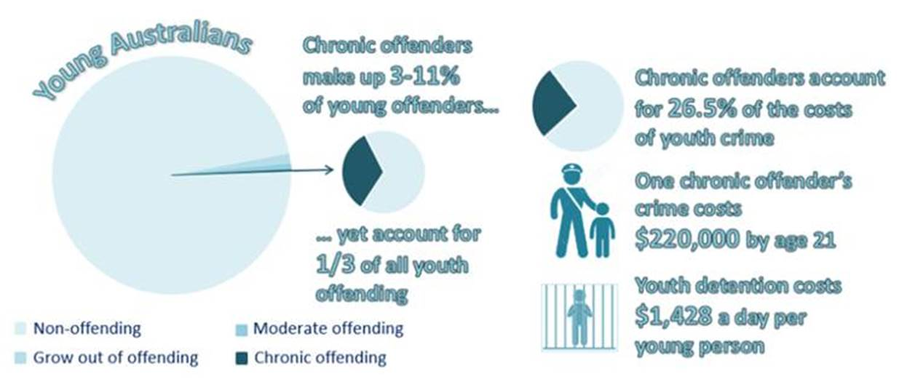
Our community’s safety….
80% of young people released from detention return within 12 months

Slide 7
And to save us money in the long run

Slide 8

We make dumb decisions when we’re young as we have a second spurt of brain development

Slide 9
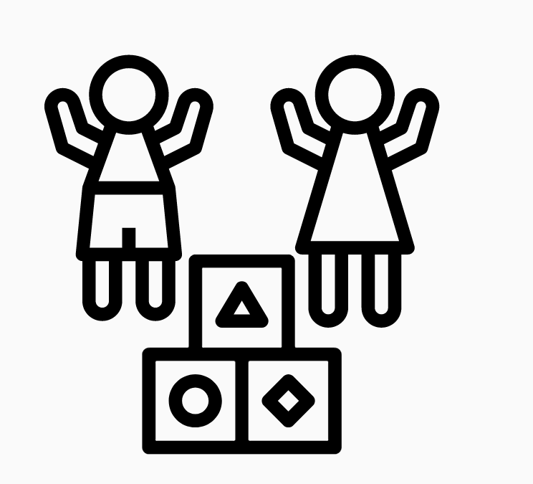
Our experiences during our first growth spurt as babies and our second as teens provide a foundation for the rest of our lives and how we grow into healthy adults and responsible citizens

Slide 10
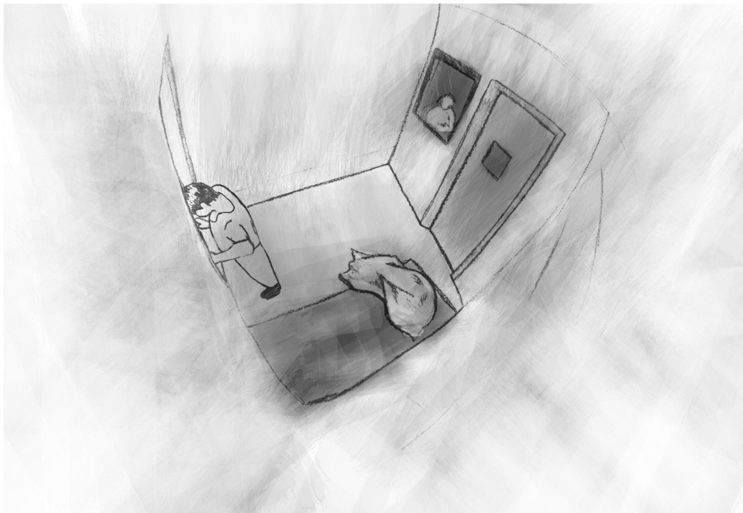
Youth detention disrupts and compromises this building process

Slide 11
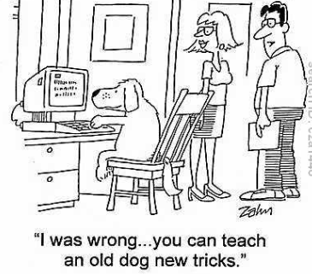
We can always learn new skills

Slide 12
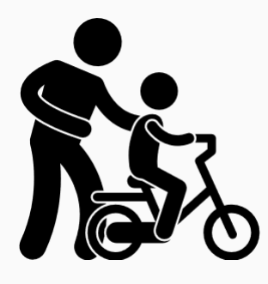
But when we’re young our brains are particularly good at picking up new things

Slide 13





But it takes time to get all our adult skills – like the ‘air traffic’ control skills we need to make good decisions: focussing, processing information and prioritising

Slide 14

Our systems play a key role in supporting young people to develop these areas of their brain

Slide 15
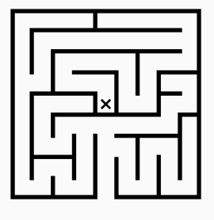

Unfortunately, often our most disadvantaged kids miss out on many of these opportunities by getting stuck in the maze of the justice system

Slide 16

Let’s look at the story of Oliver to understand more about what happens to young people

Slide 17
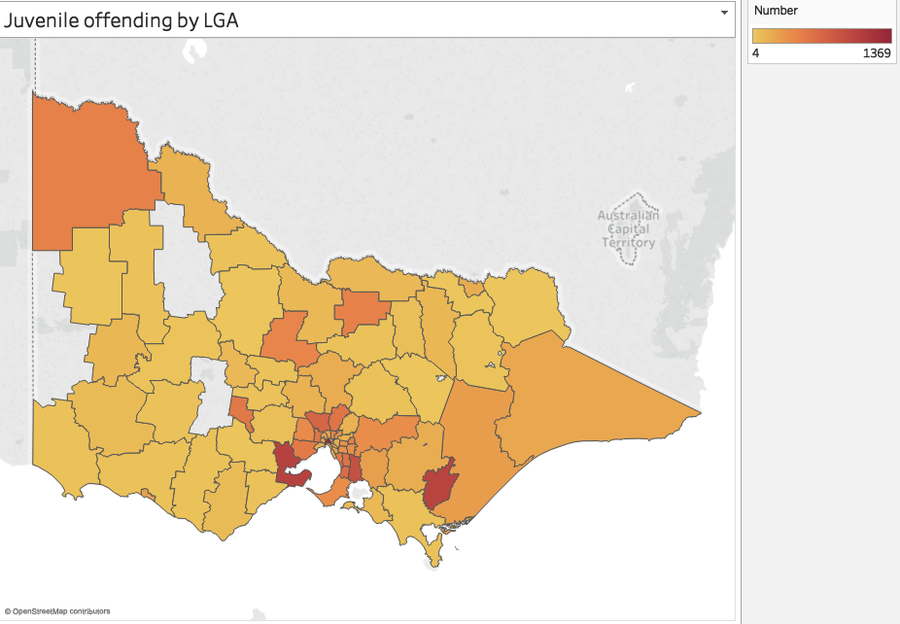
Olly grew up in one of the most disadvantaged suburbs in Victoria
The Latrobe Valley is one of Victoria’s most socio-economically disadvantaged regions, and has one of the highest rates of youth offending of any region in Victoria.

Slide 18
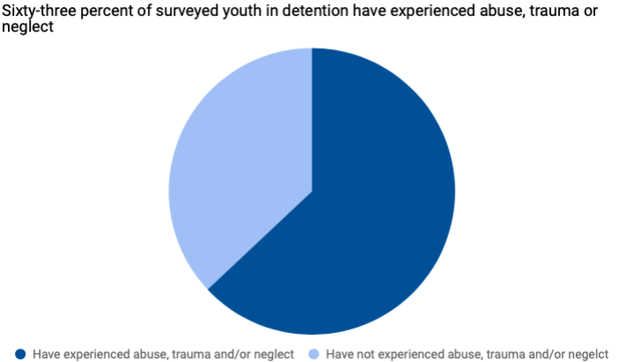

When he was three years old, Olly was taken to hospital for suspicious injuries and child protection authorities were notified

Slide 19

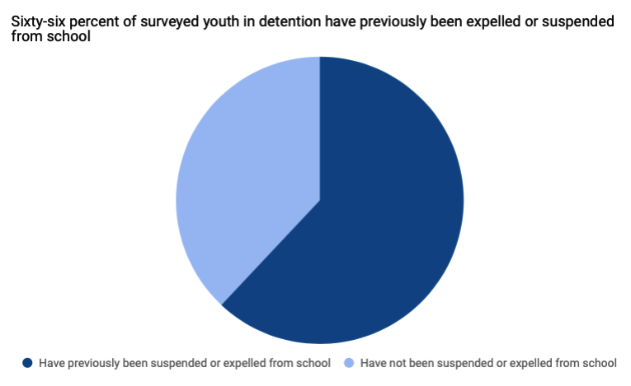

When Olly got to school he found it difficult to concentrate and started getting in trouble
Graph around intellectual disability and education outcomes

Slide 20

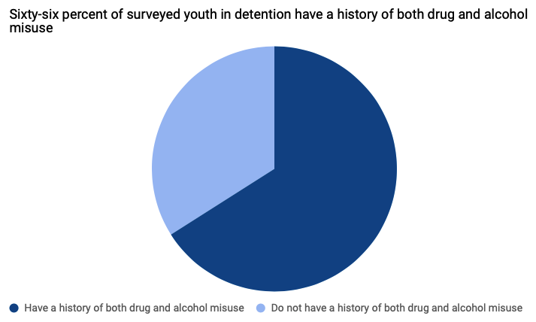
Things weren’t going great at school or home so Olly started finding things that made him feel better

Slide 21
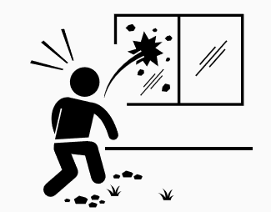
And finding things to do while he was bored and couldn’t go home
A 2016 SAC report examining offending patterns for young people sentenced in the Children's Court of Victoria found that offenders who were first sentenced at an earlier age tended to have higher reoffending rates than those first sentenced at a later age.[footnote 130] Children sentenced to youth detention before they are 10–12 years old reoffend at a rate of 86 per cent, more than double the rate of those first sentenced at 19–20 years old, which is 33 per cent.[footnote 131]
Further, the younger a child is at first sentence, the more likely they are to reoffend and to reoffend violently, and to be imprisoned in an adult prison before their 22nd birthday.[footnote 132] After accounting for the effect of other factors, each additional year in age at entry into the criminal courts was associated with an 18 per cent decline in the likelihood of reoffending.

Slide 22

After getting in trouble a few times, the police charged Olly but couldn’t find a family member that could care for him and he was placed on remand in a youth detention centre
In June 2018, there were an average of 67 young people on remand on any given night.

Slide 23

While on remand, Olly couldn’t access many services and often was locked down in his cell alone. Bored and lonely he would act out.
In the 18 months up to July 2016 there were an average of 8.8 isolations per day and 1 lockdown per day across youth justice facilities

Slide 24

Oliver did things that weren’t OK – but the system’s responses didn’t help him learn but just made him angrier and more isolated.
Olly’s family struggled with their own issues and didn’t help him learn how to manage his feelings and make good decisions.
School and the justice system didn’t help him to do it either.
This leaves a young adult on a pathway to struggling to find work, have healthy relationships and raise happy children.

Slide 25



Much more could have been done…
By systems to shift into the ‘right gear’ for Olly – such as providing extra help at school or support to his family
To get Olly help from experts to restore levelness after experiences that left his brain like a ‘wobbly table’
With communities experiencing disadvantage to ensure young people growing up in them get as many ‘positive’ weights on their resilience scales – especially if they’ve got ‘negative’ weights like violence or poverty on them

Slide 26
Evidence
Frameworks Institute: www.frameworksinstitute.org%2Fassets%2Ffiles%2Fjuvenilejusticereform_mm_2015.pdf
The same Four Walls: https://ccyp.vic.gov.au/assets/Publications-inquiries/The-Same-Four-Walls1.pdf
https://ama.com.au/position-statement/health-and-criminal-justice-system-2012
https://www.aihw.gov.au/reports/youth-justice/young-people-returning-to-youth-justice-1617/contents/table-of-contents
https://www.parliament.vic.gov.au/publications/research-papers/download/36-research-papers/13806-youth-justice-in-victoria

Slide 27
Icons/images
jacob massey
Matt Brooks
dDara
Adrien Coquet
FORMGUT
BomSymbols
Massupa Kaewgahya
Cartoonstock.com
Gan Khoon Lay
StoneHub and Nikita Kozin and Luis Prado
Andrey Maleev and vectoriconset10
Adrien Coquet
Priyanka
Pedro Santos and Creative Stall and Maxim Kulikov

Slide 28
Datasets
Youth offending Victoria
https://www.crimestatistics.vic.gov.au/crime-statisticslatest-crime-data/download-data Data Tables - Spotlight: Youth Offending in Victoria - year ending March 2019 (XLSX, 219.61 KB)
Youth detention population data
https://www.aihw.gov.au/reports/juv/128/youth-detention-population-in-australia-2018/contents/table-of-contents
SEIFA data
https://www.abs.gov.au/websitedbs/censushome.nsf/home/seifa
Youth justice snapshot survey
https://ccyp.vic.gov.au/assets/Publications-inquiries/The-Same-Four-Walls1.pdf
LGA shape files
https://www.abs.gov.au/AUSSTATS/abs@.nsf/DetailsPage/1270.0.55.003July%202016?OpenDocument
To choose name of archetype
https://www.bdm.vic.gov.au/sites/default/files/embridge_cache/emshare/original/public/2019/01/e5/81409f4b0/Top%20100%20Baby%20names%202018.xlsx

